Slide 1
Musical Descriptors
A multivariate analysis of cognitive listening space

Slide 2
The Project
Concept, Origin, and Questions
Data Collection & Analysis
Results & Discussion
Questions for Discussion
Notes:
The concept and origin of this study initially come from the Food Engineering lab of the Charles Viollette Research institute in Lille, France.
They were working on a project comparing intersensory cross modal mapping, specifically music listening to beer taste. The goal was to see how people associate certain music with beer. I was invited to help with data analysis, and as a musical consultant because my background is in music education and performance.
The music that they were using initially was six different versions of the same musical excerpt: major and minor versions, each at three different tempos. Initial analyses revealed no differences in how people associated beers with the music.
It was clear after listening to the excerpts that there wasn’t enough variation in the music to actually see a difference.

Slide 3
Questions
Problem:
Music is massively multi-dimensional.
Questions:
Is there a way to evaluate music so that we can establish a music listening ‘space’?
Can these then be compared to other sensory domains?
Can we find exemplars that anchor that space?
Are there differences by culture or nationality?
Notes:
Some sensory spaces are already fairly well defined, one example is Wine Tasting. So the problem we were facing is that in order to evaluate a cognitive ‘space’ for music listening, we need to figure out what kind of space it would be in the first place. We realized that we were going to need a lot more music, So I wrote thirty 30-second string quartet excerpts. The musically ‘defined’ quality that we controlled for was timbre, and that was pretty much it.
We then selected 33 terms taken from musical texts; either music analyses or directly from scores, as instructions. These were selected in part by myself and my collaborator and in conjunction with a professional French musician. We attempted to select only words that were not ‘explicitly’ musical, i.e. major or minor, and we selected words that had clear translations in both English and French.
The goal of this was initially to find exemplars of the musical excerpts that the sensory evaluation lab could use in their beer taste experiments, but it’s kind of taken on a life of its own and I’m very excited to be pursuing this.

Slide 4
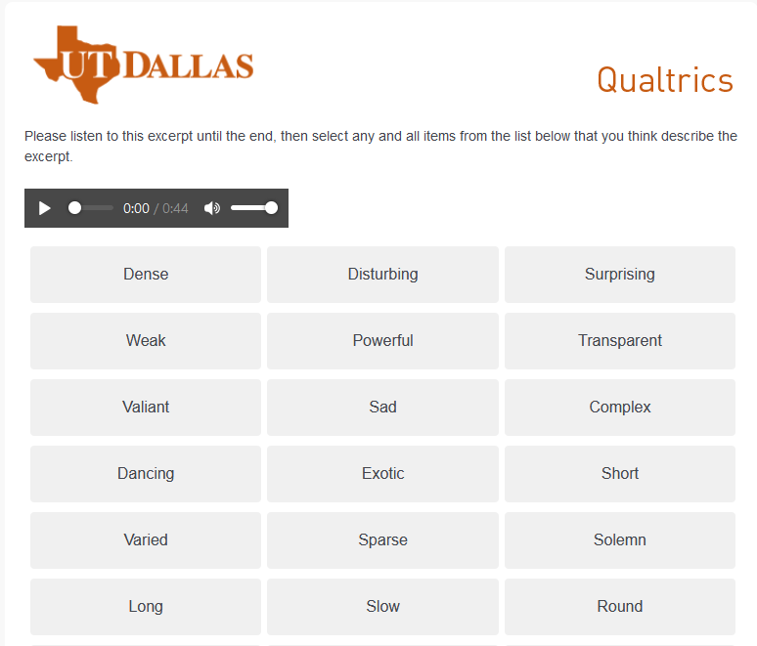
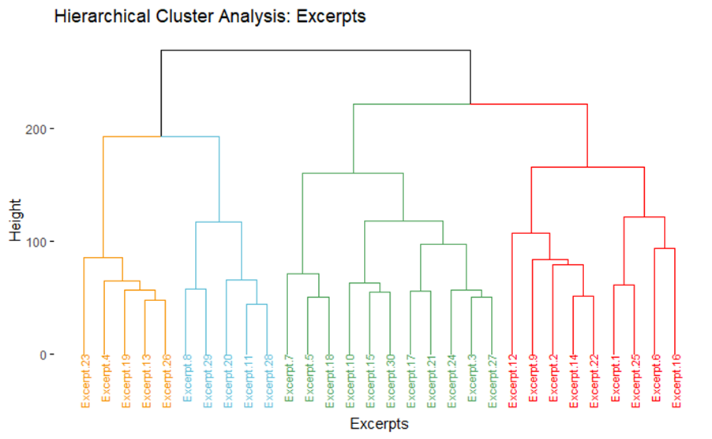
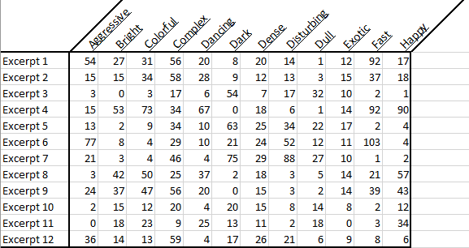
Data
Collection paradigm:
Check all that apply (CATA)
Sensory Evaluation (Meyners & Castura, 2014)
Also known as ‘pick any/N’ (Coombs, 1964)
Analysis:
Hierarchical Clustering
Distance/R_{V} analysis (Abdi et al., 2008)
Correspondence analysis (CA)
Notes:
CATA, or Check-all-that-apply, is a survey technique commonly used in sensory evaluation. Participants are presented with a stimulus and then a list, and asked to check or select each of the options that they thing applies. In this case, participants were presented with a musical stimulus and asked to select any and all adjectives that they felt described that stimulus.
For the analysis, we used three primary analyses: Hierarchical clustering analysis to see what groups of excerpts arose in this task, Distance analyses to see how similarly or differently participants rated the excerpts, and correspondence analysis, which is similar to Principal Components Analysis, but allows for the analysis of qualitative data.

Slide 5
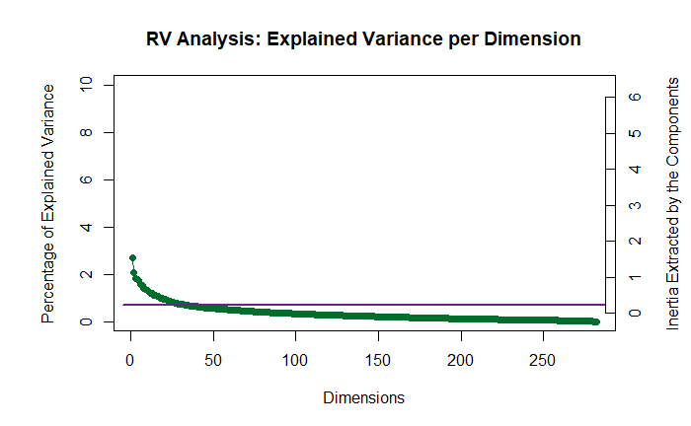
Results: Participants

Slide 6
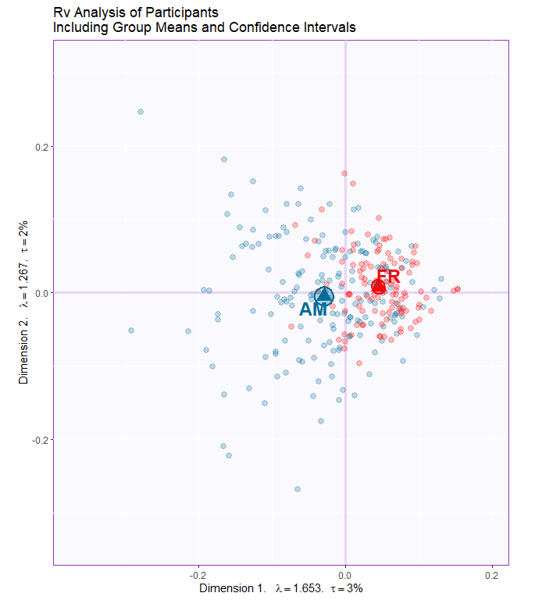
Results: Participants
Data Points:
American (n = 171) & French (n = 111)
R_{V} analysis
MDS on R_{V} matrix
Significant group differences (p < .001)
Notes:
A total of 520 survey responses were collected. We were specifically investigating differences between American and French participants. All participants who included “American” in their response somehow (i.e., Asian American, Mexican-American, etc. were included. Those who listed solely another nationality were excluded from this analysis, but their data was preserved for future analyses. After cleaning incomplete responses and selecting only the responses that matched the criteria, we analyzed the data and found that there were, in fact, group-level differences in how French and American participants described the music.
What you see in this plot are the results of the distance analysis. Distance analysis plots the similarity & difference of all the participants in a single plot. In this plot, blue dots are American participants and red dots are French participants. The triangles are the means and the ellipses around the triangles are the bootstrapped confidence intervals of where the means might lie. We ran 1000 iterations, so this suggests that there are group differences significant at the level of p < .001

Slide 7
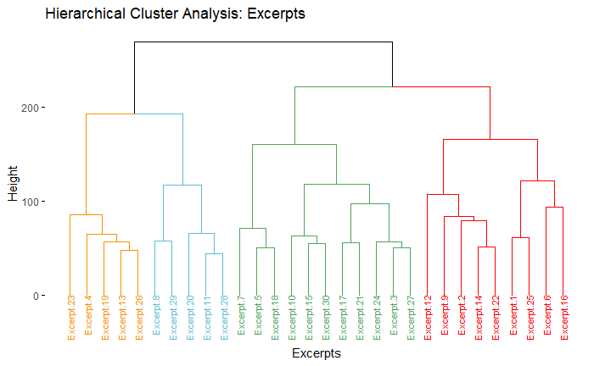
Results: Excerpts

Slide 8
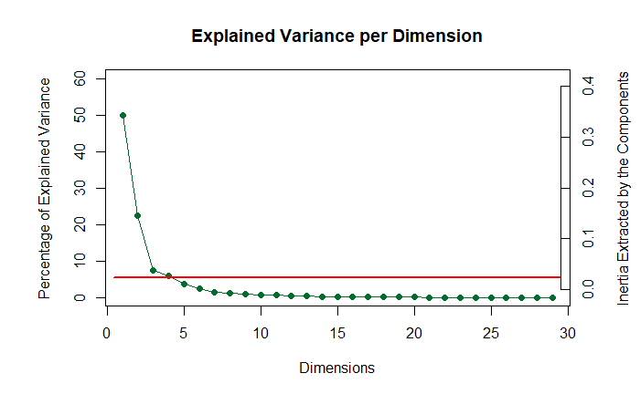
Results: Excerpts

Slide 9
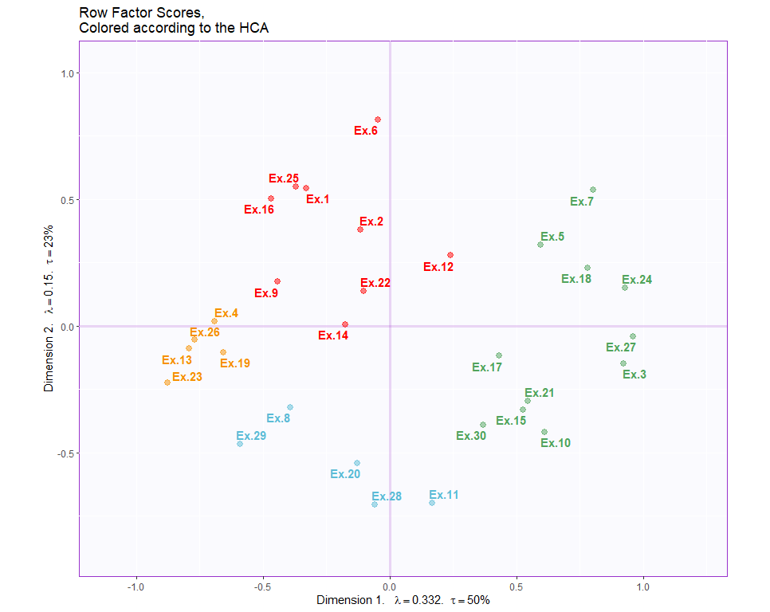
Results: Excerpts
Notes:
Because we didn’t use a priori groups for the excerpts, we used a hierarchical cluster analysis to determine whether groups arose out of the ratings. We found four clear groups, distributed around the space, as you see here.
Arbitrarily title groups: Yellow = Group 1, Blue = group 2, green = group 3, red = group 4
Correspondence analysis analyzes a contingency table, or pseudo-contingency table, in which the observations are on the rows, in this case, the excerpts, and the variables, in this case, the adjectives, are on the columns. The intersection of a row and a column tells you how many times a variable has been associated with an observation. In this case, how many times any given adjective was selected to describe a musical excerpt.
In this plot, excerpts that are closer to one another are more similar, and excerpts that are further from the origin contribute more to this space. Excerpts that are closer to the origin are more likely to be contributing to a higher dimension, i.e. the variance extracted in the first two dimensions does not account for differences among those excerpts. Examples are 14, 22, 12, and 17.
What this does is it shows us how the excerpts relate to one another quantitatively, but it doesn’t show us qualitatively how the excerpts were evaluated. For that we need to look at the column factor scores.

Slide 10
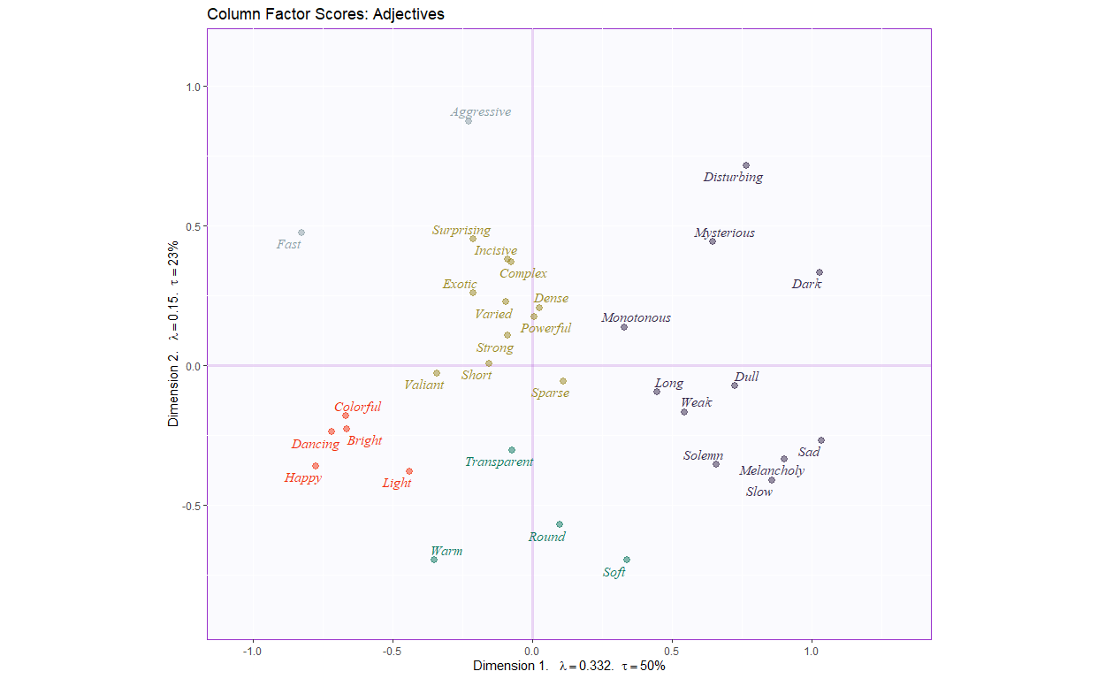
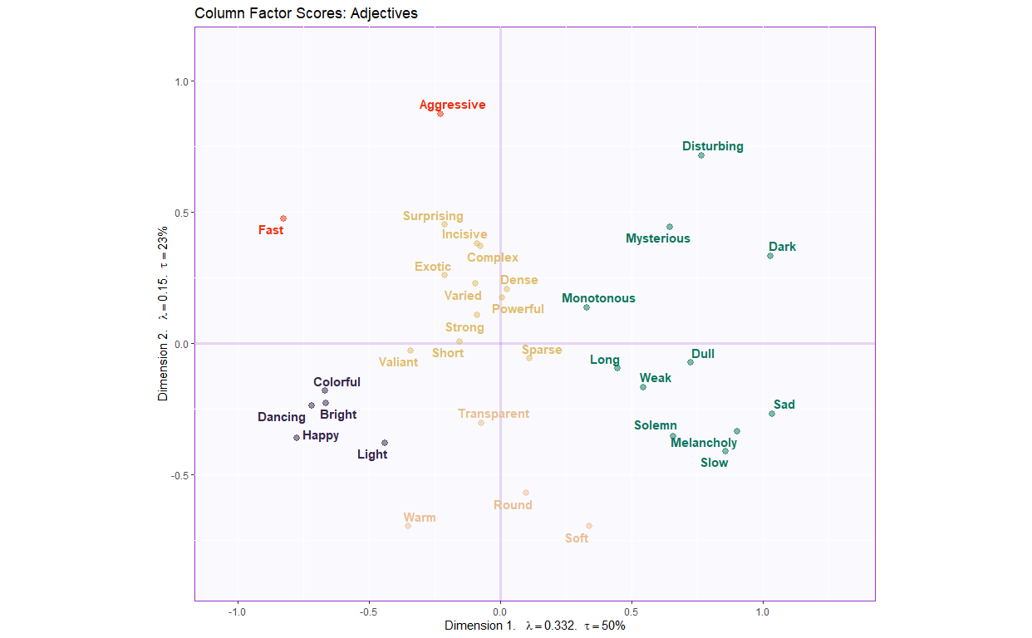
Results: Excerpts
Notes:
Because of how Correspondence Analysis works, we can make similar plots for the columns, or adjectives. In this plot, the adjectives are colored by alphabetical order.
Because we were focused on the musical aspect of this, I didn’t initially think about doing a hierarchical cluster analysis to see what groups arose among the adjectives, but that would be an interesting follow up.
What we do see here is that there is a clear 2 dimensional Valence/Arousal paradigm. On the positive end of the first dimension, we see adjectives like “Sad” and “Dark”, and on the negative end, we see “Fast”, “Dancing”, and “Happy”. This suggests that the first dimension (X axis) is the valence dimension. The second dimension is driven on the positive end by Aggressive, disturbing, surprising, and fast, and on the negative end by soft, warm, and round, suggesting that the 2nd dimension (Y axis) is arousal.
One thing I’d like to point out also is that fast and slow are about as far as they can be from one another: quadrants 2 and 4. They also are some of the furthest from the origin in both dimensions. This is because and slow both reflect aspects of valence and arousal. Generally speaking, fast is not associated with sad. Fast, negatively valenced stimuli are often evaluated as ‘angry’, and slow, positively valenced stimuli are often evaluated as ‘calm’.

Slide 11
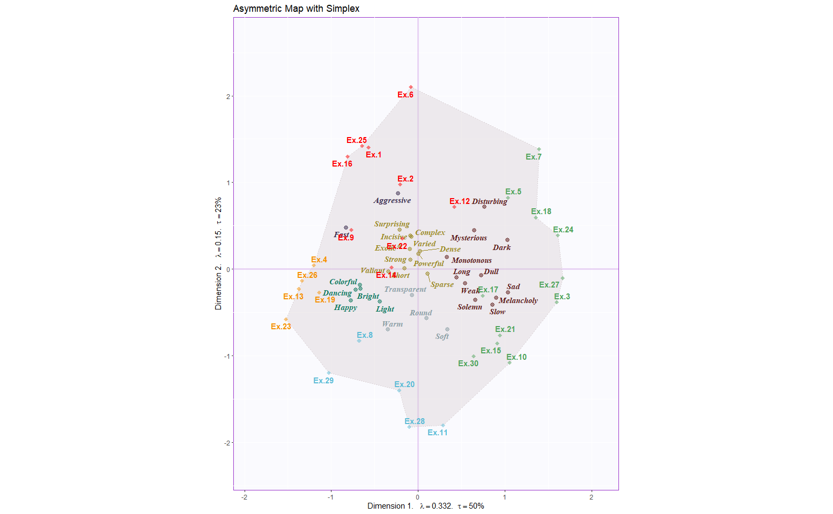

Results: Excerpts
Notes:
This shows us the excerpts and the adjectives plotted in the same space. This can be interpreted directly; excerpts and adjectives can be evaluated both by distance and by the angle between them. Excerpts that are closer to one another are more similar, and adjectives that are closer to excerpts were more commonly associated with that excerpt.
The simplex, the polygon in the middle, is the two-dimensional projection of the n-dimensional adjective space into the excerpts space. This gives us a space where we can see how the excerpts were associated with the adjectives. I’ve included some examples to listen to, so we can see how things turned out.
A few limitations I’d like to acknowledge: I do recognize that as the composer, my own internal compositional biases were revealed. We ran another survey in which we asked musical experts to evaluate the excerpts on various musical qualities, and a few stood out as outliers (excerpt 6 and 14), suggesting that although the stimuli are grouped together in this way when they aren’t evaluated using specific, defined musical excerpts, when we use musical terms, the factor space may be determined by musical family.
For example, although genre is a specific quality and we asked musically trained excerpts to pick between Classical, Baroque, Impressionist, Modern, etc., most of the excerpts could generally be classified as western tonal art music. The minimalist example (6) and the jazz example (14) would likely not be classified in that general family. This is actually one of our future directions – to include excerpts from other musical cultures, to see how robust something like the CATA adjectives task is.

Slide 12
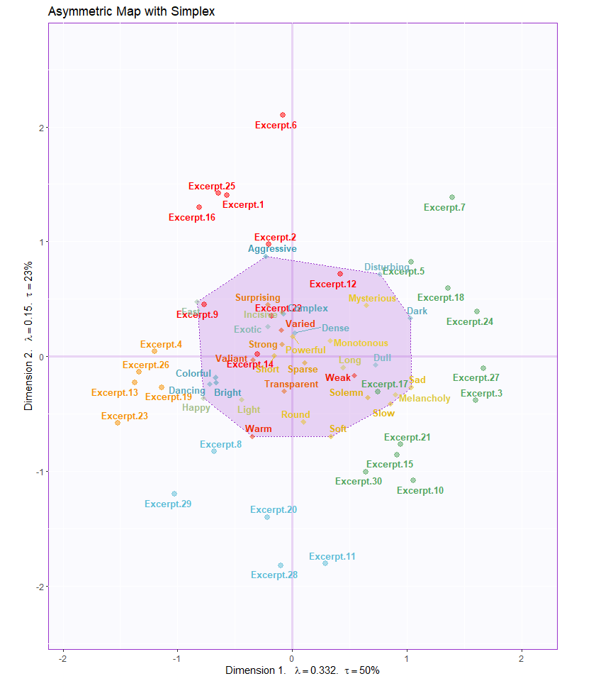
Results: Excerpts
Notes:
This shows us the excerpts and the adjectives plotted in the same space. This can be interpreted directly; excerpts and adjectives can be evaluated both by distance and by the angle between them. Excerpts that are closer to one another are more similar, and adjectives that are closer to excerpts were more commonly associated with that excerpt.
The simplex, the polygon in the middle, is the two-dimensional projection of the n-dimensional adjective space into the excerpts space. This gives us a space where we can see how the excerpts were associated with the adjectives. I’ve included some examples to listen to, so we can see how things turned out.
A few limitations I’d like to acknowledge: I do recognize that as the composer, my own internal compositional biases were revealed. We ran another survey in which we asked musical experts to evaluate the excerpts on various musical qualities, and a few stood out as outliers (excerpt 6 and 14), suggesting that although the stimuli are grouped together in this way when they aren’t evaluated using specific, defined musical excerpts, when we use musical terms, the factor space may be determined by musical family.
For example, although genre is a specific quality and we asked musically trained excerpts to pick between Classical, Baroque, Impressionist, Modern, etc., most of the excerpts could generally be classified as western tonal art music. The minimalist example (6) and the jazz example (14) would likely not be classified in that general family. This is actually one of our future directions – to include excerpts from other musical cultures, to see how robust something like the CATA adjectives task is.

Slide 13
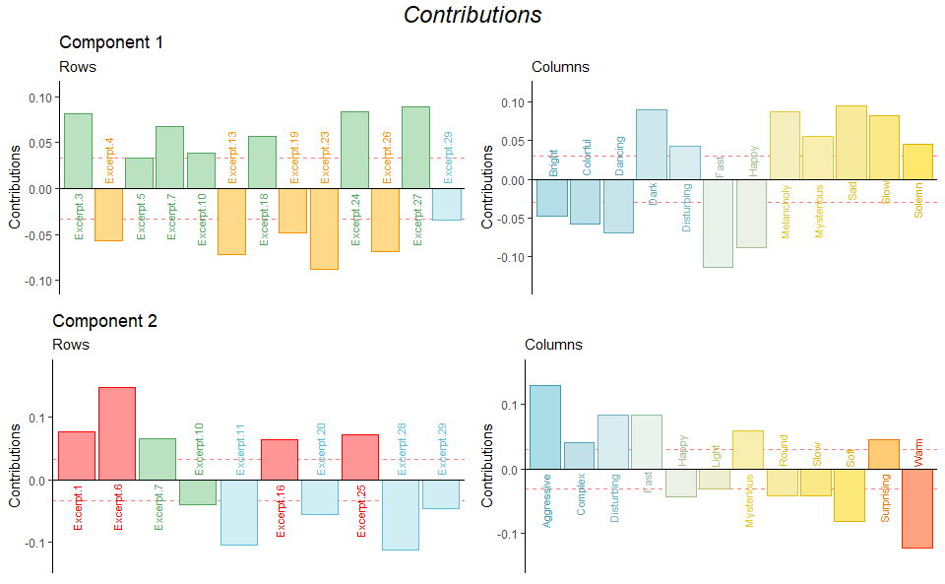
Results: Excerpts

Slide 14
Thanks
Institute Charles Viollette - Food Quality and Security:
Dr. Sylvie Chollet
Dr. Mathilde Vandenberghe-Descamps
UTD Multivariate Stats Lab:
Dr. Hervé Abdi
Ju-Chi Yu
Luke Moraglia
UTD Music Perception & Cognition Lab:
Dr. W. Jay Dowling
Dr. Rachna Raman
Kieth Gryder
Melanie Holmes
Additional thanks:
Dr. Scott Schumann, Central Michigan University

Slide 15
Questions for discussion
Is this analytical approach useful in your specific domain? How so?
How might people use music in their creative process? Does this provide insight into that mechanism? How?
How might the results differ if we used other words, maybe words not taken from the music domain?
Why are there differences between French & American listeners?

